Slide 1
Employee Performance Analysis

Slide 2
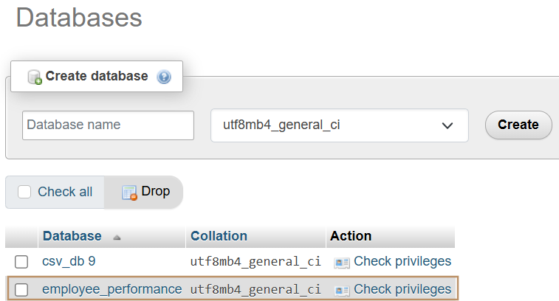
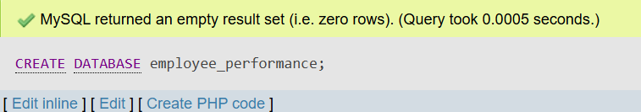
CREATE DATABASE
QUERY:
CREATE DATABASE employee_performance;

Slide 3
IMPORT TABLE
Importing 3 tables into employee_performance database.
data_science_team.csv
proj_table.csv
emp_record_table.csv
Next to check if the tables are successfully imported, we will use the below query.

Slide 4
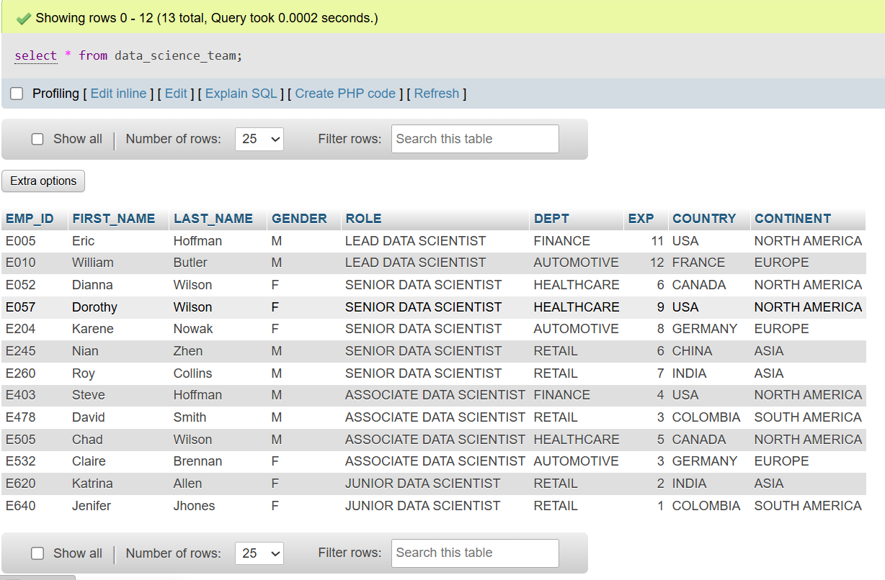
Query:
SELECT * FROM data_science_team;

Slide 5
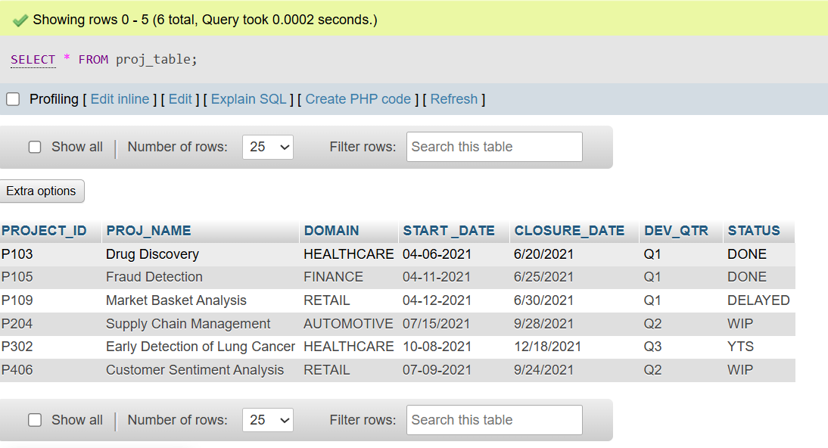
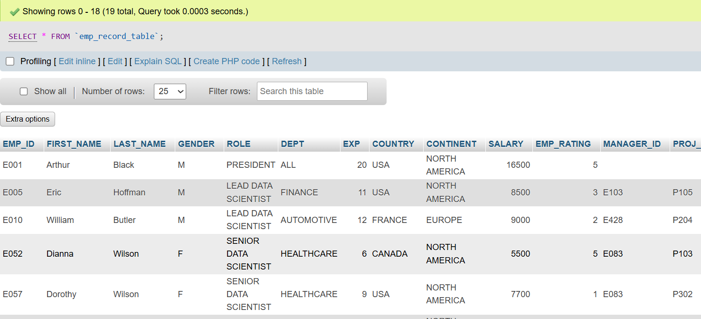
Query: Query:
SELECT * FROM proj_table; SELECT * FROM emp_record_table;

Slide 6
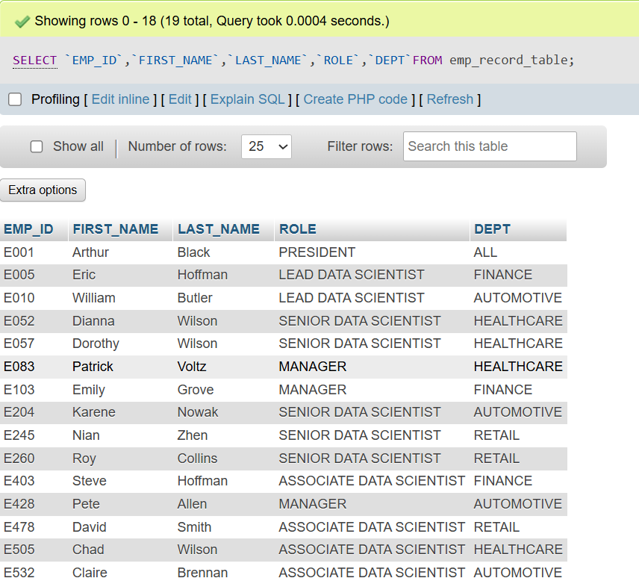
Query:
SELECT `EMP_ID`,`FIRST_NAME`,`LAST_NAME`,`ROLE`,`DEPT`FROM emp_record_table;

Slide 7
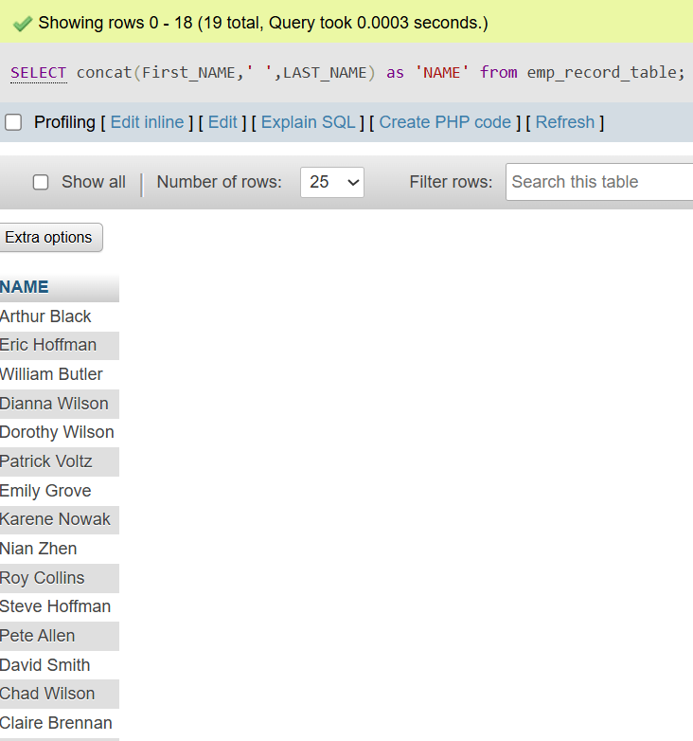
Concatenate
Concatenate the FIRST_NAME and the LAST_NAME of employees in the emp_record_table.
Query:
SELECT concat(First_NAME,' ',LAST_NAME) as
'NAME' from emp_record_table;

Slide 8
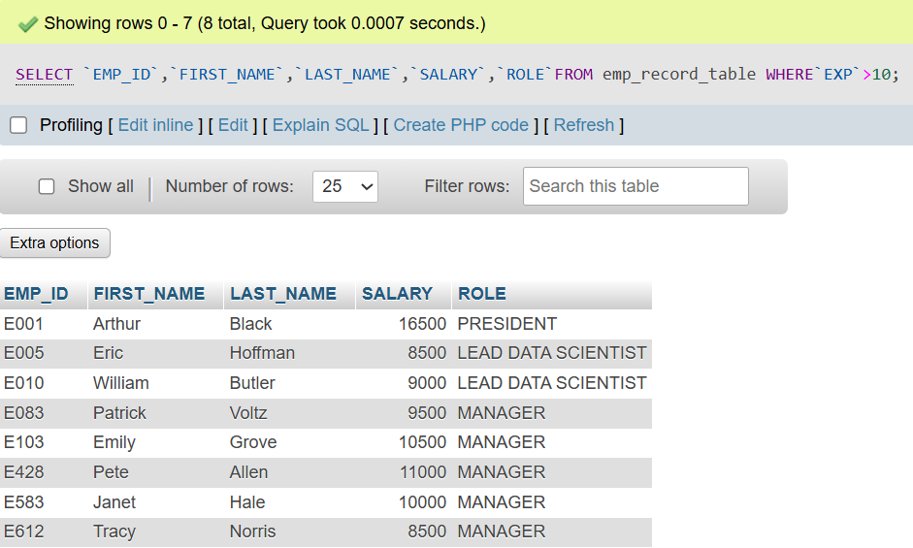
WHERE
Query:
SELECT `EMP_ID`,`FIRST_NAME`,`LAST_NAME`,`SALARY`,`ROLE`FROM emp_record_table
WHERE`EXP`>10;

Slide 9
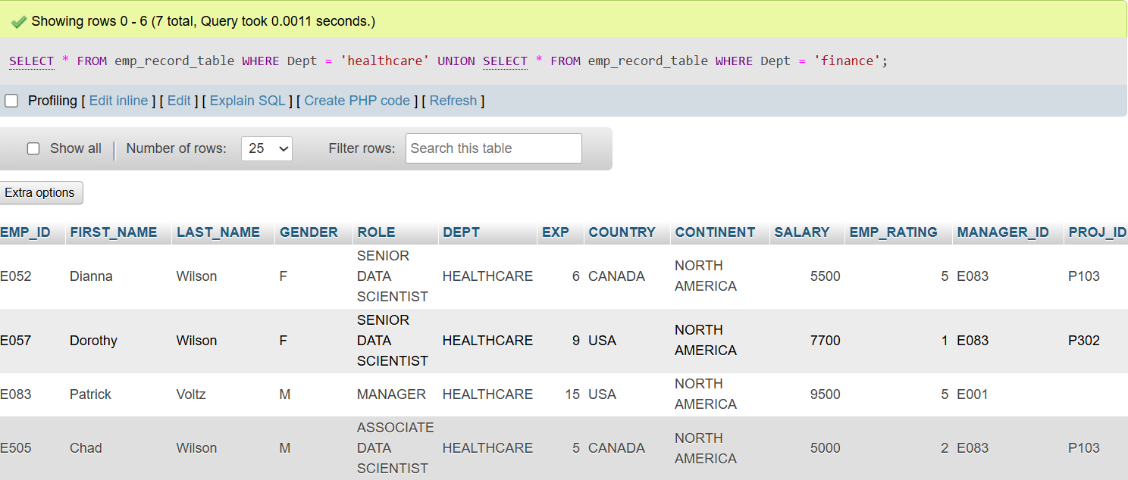
UNION
Query:
SELECT * FROM emp_record_table WHERE Dept = 'healthcare’
UNION
SELECT * FROM emp_record_table WHERE Dept = 'finance';

Slide 10
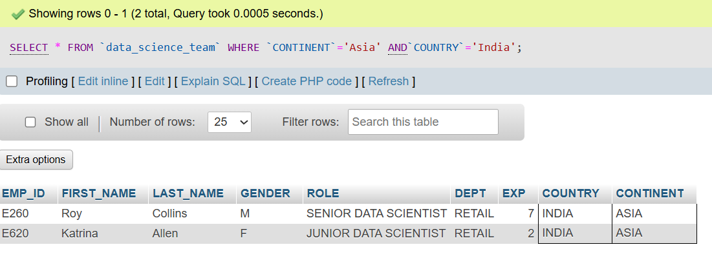
AND
Query:
SELECT * FROM `data_science_team` WHERE `CONTINENT`='Asia' AND`COUNTRY`='India';

Slide 11
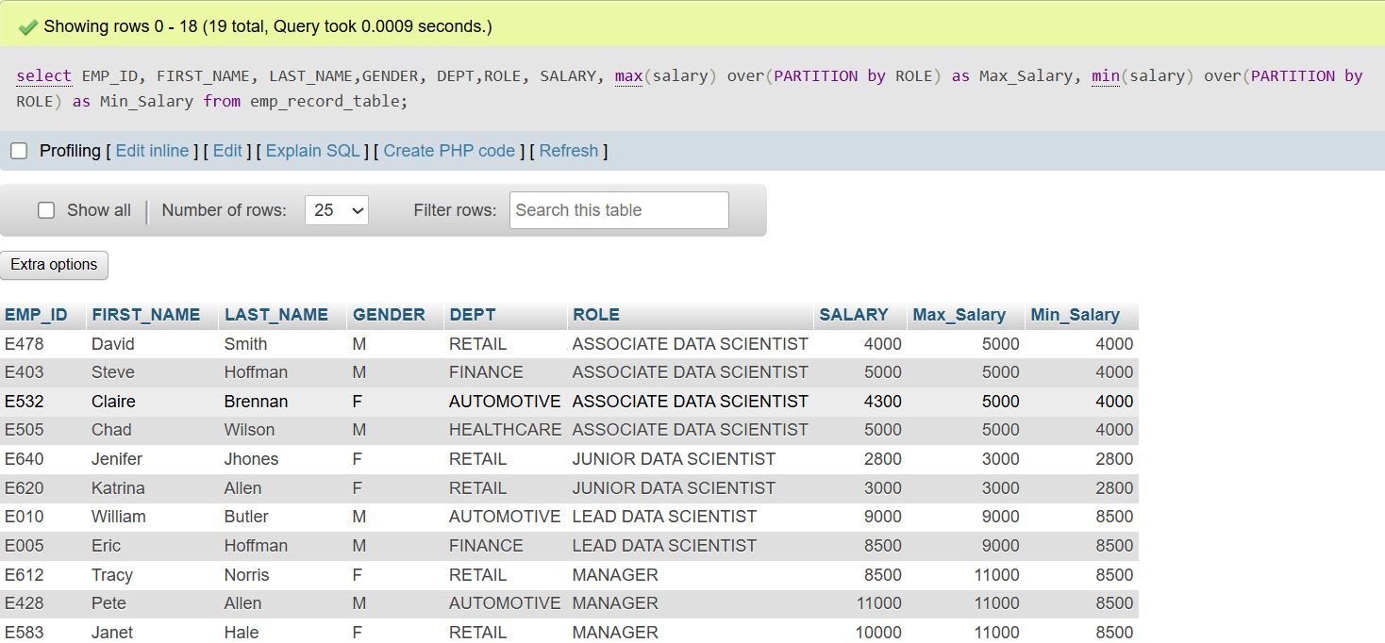
MINIMUM AND MAXIMUM
Query:
SELECT EMP_ID, FIRST_NAME, LAST_NAME,GENDER, DEPT,ROLE, SALARY,
max(salary) over(PARTITION by ROLE) as Max_Salary,
min(salary) over(PARTITION by ROLE) as Min_Salary
FROM emp_record_table;

Slide 12
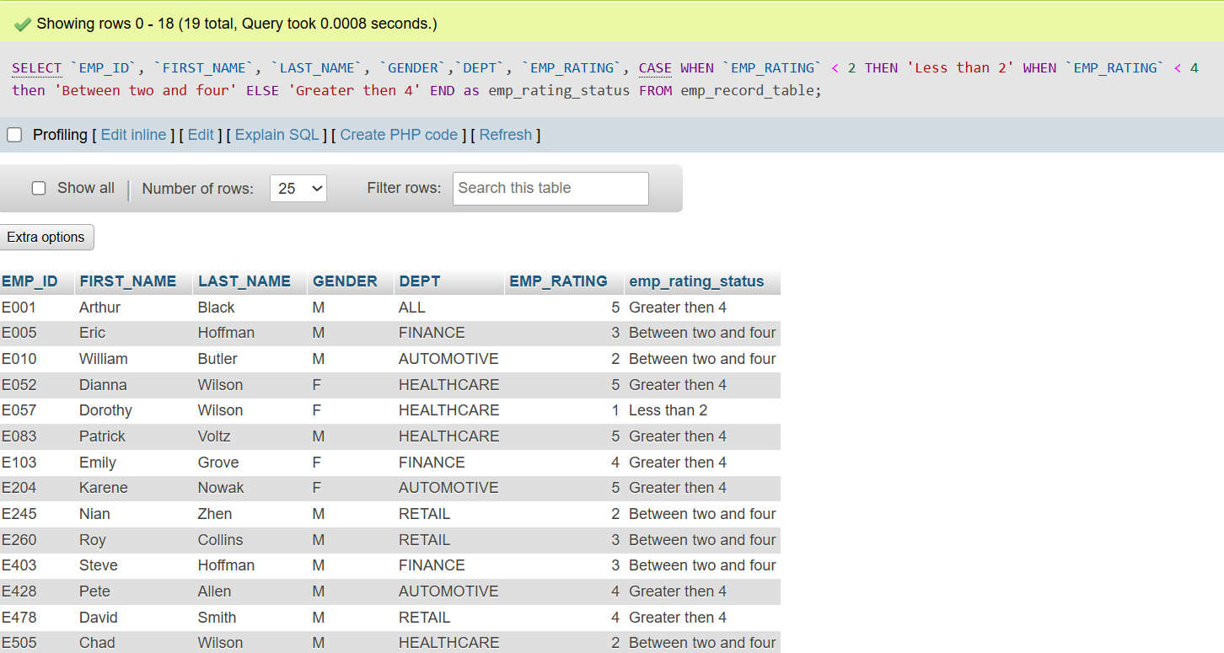
CASE
Query:
SELECT `EMP_ID`, `FIRST_NAME`, `LAST_NAME`, `GENDER`,`DEPT`, `EMP_RATING`,
CASE
WHEN `EMP_RATING` < 2 THEN 'Less than 2'
WHEN `EMP_RATING` < 4 then 'Between two and four'
ELSE 'Greater then 4'
END as emp_rating_status
FROM emp_record_table;

Slide 13
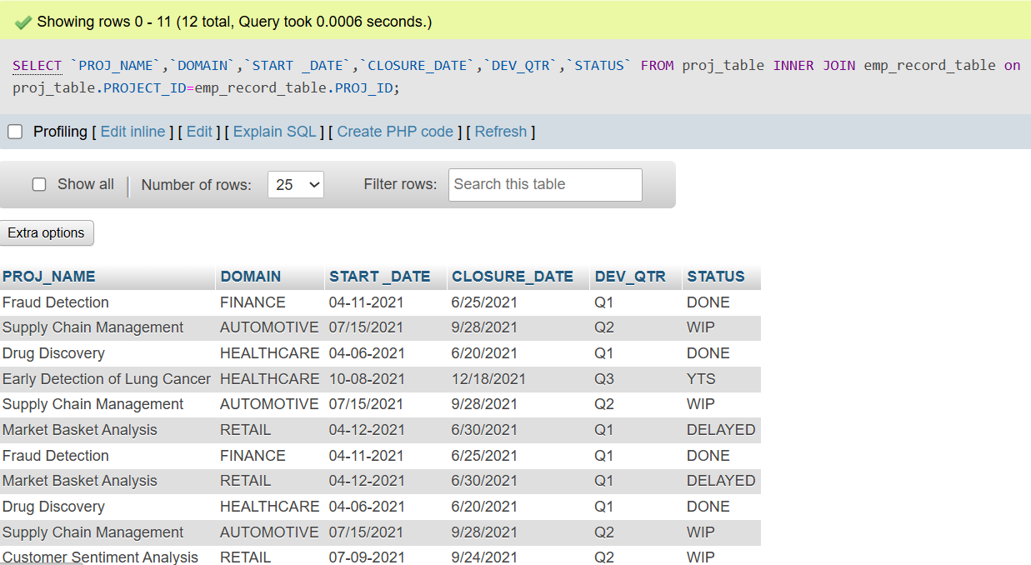
INNER JOIN
Query:
SELECT `PROJ_NAME`,`DOMAIN`,`START _DATE`,`CLOSURE_DATE`,`DEV_QTR`,`STATUS`
FROM proj_table
INNER JOIN emp_record_table on proj_table.PROJECT_ID=emp_record_table.PROJ_ID;

Slide 14
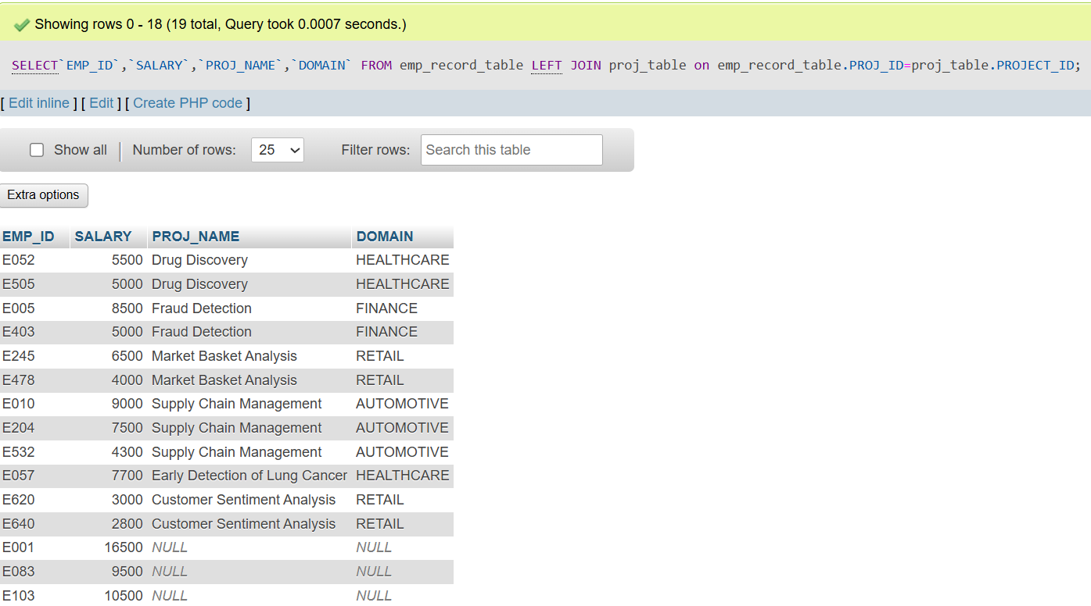
LEFT JOIN
Query:
SELECT`EMP_ID`,`SALARY`,`PROJ_NAME`,`DOMAIN`
FROM emp_record_table
LEFT JOIN proj_table on emp_record_table.PROJ_ID=proj_table.PROJECT_ID;

Slide 15
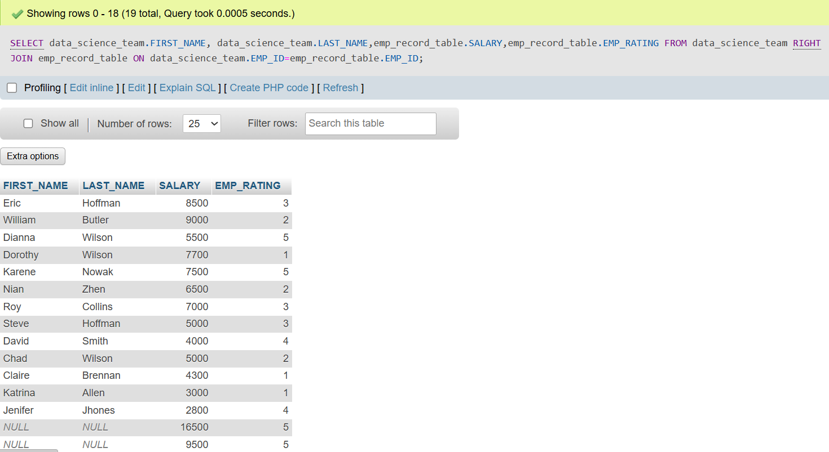
RIGHT JOIN
Query:
SELECT data_science_team.FIRST_NAME, data_science_team.LAST_NAME,emp_record_table.SALARY,emp_record_table.EMP_RATING
FROM data_science_team
RIGHT JOIN emp_record_table ON data_science_team.EMP_ID=emp_record_table.EMP_ID;

Slide 16
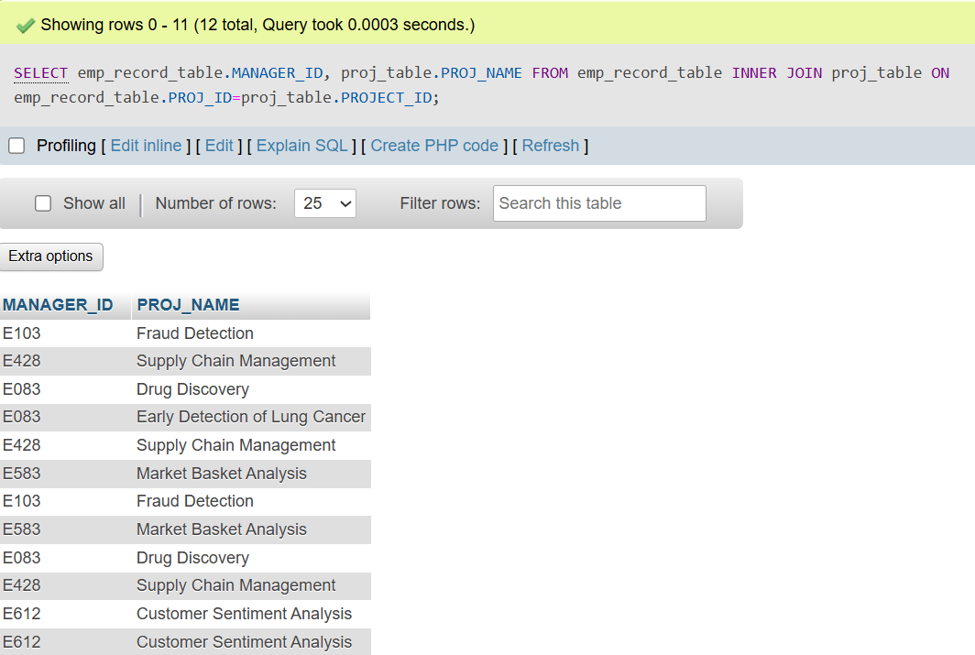
FULL JOIN
Query:
SELECT emp_record_table.MANAGER_ID, proj_table.PROJ_NAME
FROM emp_record_table
INNER JOIN proj_table
ON emp_record_table.PROJ_ID=proj_table.PROJECT_ID;

Slide 17
THANK YOU!

